Slide 1
UWB localization techniques

Slide 2
Interpretation of Data
Two-way time-of-arrival (TW-TOA)
Time-difference-of-arrival (TDOA)
Position Calculation Algorithms
Trilateration
Triangulation

Slide 3
Interpretation of Data
Time of Flight(TOF)
TOF is a positioning method based on two way ranging. That means the tag needs to send and receive signals of the anchor several times and then the flight time of the signal between the anchor and the tag can be measured,as radio waves travel at the speed of light, we can calculate the distance between the tag and each anchor.
With the TOF method ,the UWB tag should complete the ranging with each anchor.
For example,there are one tag and three anchor,AP1~AP3 refer to three anchors respectively.When the ranging between Tag and three anchors is finished, there will be three corresponding distance values d1~d3. With each anchor as the center of the circle, the intersection of three circles at one point is the location of Tag.

Slide 4
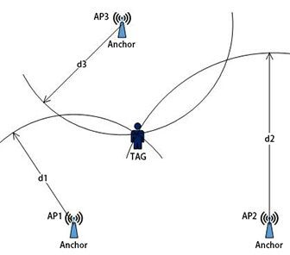
In the one - dimensional mode, if we have two anchors to ranging and then we can get the tag’s location.For the two-dimensional mode,three anchors can be needed and if you want get X, Y and Z coordinates of the tag, four anchors are required.

Slide 5
Time Difference of Arrival(TDOA)
TDOA is localization based on comparing the time difference between signals and each anchor and this technique requires Accurate time synchronization function.
When using the TDOA method, the UWB tag will send out poll message and all the nearby UWB anchors will receive it and record the arrival time. Because the location of anchors is different, so anchors won’t receive the message at the same time. We can use these time differences to determine the tag’s location.
If there are three anchors and one tag, AP1~AP3 refer to three anchors .When the tag completes communication with three anchors, there will be three corresponding different arrival times (T1~T3) and then we calculate the distance difference between the signal source and each anchor.
Since the distance difference between the tag and AP1,AP2 is a constant, we can draw a hyperbola .In any two groups of anchors, the intersection of two hyperbola points is the location of Tag.

Slide 6
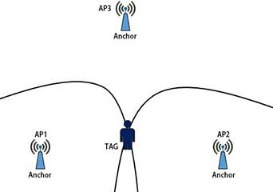
The key point of this method is to keep all anchors in sync. There are two kinds of time synchronization including wired and wireless methods.The former synchronization accuracy is higher,but the network maintenance is complex because of the wired connection .
Another is wireless synchronization, the accuracy is a little less than the wired time synchronization, but the system is simple because the data can be transmitted by WiFi and will greatly reduce total costs.
When finishing the time synchronization, The tag sends a broadcast message, and all the anchors will send the timestamp of receiving this message to the server, and the server will calculate the location of the tag.

Slide 7
Comparison
When choosing positioning methods ,may factors should be considered.
System Capacity
The TOF method is based on two-way ranging between the tag and each anchor, and UWB tags needs to send and receive signals of the anchor several times during every two way ranging ,while in TDOA method, tag only needs to send one broadcast message and finish the positioning,Therefore, the TDOA system capacity is higher and 1500 tags can possibly be located .
Power Consumption
Since anchors are generally powered by the alternating current and tags are battery-powered.
The TOF requires UWB tags to finish ranging with each anchor and must send out and receive signals several times during each ranging,which will reduce the battery life . In TDoA positioning, the tag only needs to send one broadcast message ,it can be completed within 0.5 ms from the preparation to the sending, and its battery life is longer .

Slide 8
Environmental requirements
TDoA is based on the arrival time difference and Hyperbolic algorithm is generally adopted to calculate location. The positioning accuracy is high within the area enclosed by anchors, but poor outside the area.Therefore, we have to use TOF when the tag is on the periphery of the anchor. Besides,complex environmental scenarios such as power plants,so it is difficult to meet project requirements with TDOA positioning because of the difficult system construction, In this mode, TOF positioning can be better.

Slide 9
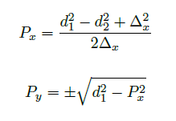
Position Calculation Algorithms
Trilateration
Trilateration is a popular algorithm for positioning systems. For instance, GPS systems today use trilateration to convert distance measurements of satellite positions to coordinates of the object.
2D SPACE:
Assuming two anchor points, A1 and A2, and the distances, d1 and d2, between the anchors and the position of the object
A position, P, can be determined using 2D-trilateration. For an easier solution a 2D-plane is defined with the line between two anchor points on the x-axis. The anchor points are defined to be separated by x on the axis. One solution to find the position, P, is to use Pythagoras’ theorem.
There exists two solutions for the Py coordinate. Where one will be the true solution and the other an ambiguous solution

Slide 10
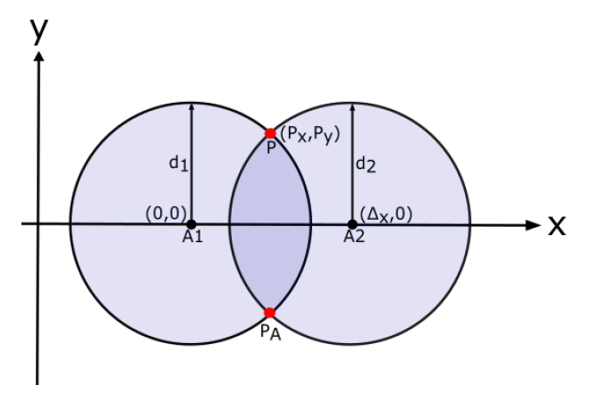
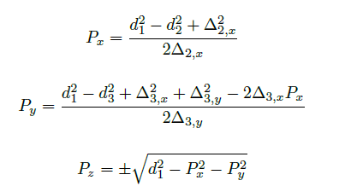
Both the true solution and the ambiguous solution can be seen by the intersections of the circles.
The true solution is denoted by P and the ambiguous solution by PA. The anchor-points are denoted by A1 and A2.
3D SPACE:
The solutions in 3D-space are found using Pythagoras theorem similarly to the solution in 2D-space.
The equations to find the position, P, are:
Here d1,d2,d3 denote the distance between the anchors and the position of the object .

Slide 11
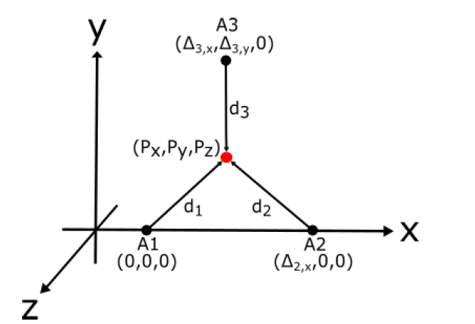
The true solution is denoted by P and anchor-points for the trilateration are denoted by A1, A2 and A3

Slide 12
Triangulation
Instead of utilizing distances, like trilateration does, triangulation uses angles to position an object within an area.
One of the advantages of using triangulation is that the orientation of the object can be determined in a client-based positioning system.
While getting an orientation is an improvement, the geometry of triangulation is a complicated matter and can cause inconsistencies if not handled correctly.
To reliably find the position of an object with triangulation, three anchor-points are needed.

Slide 13
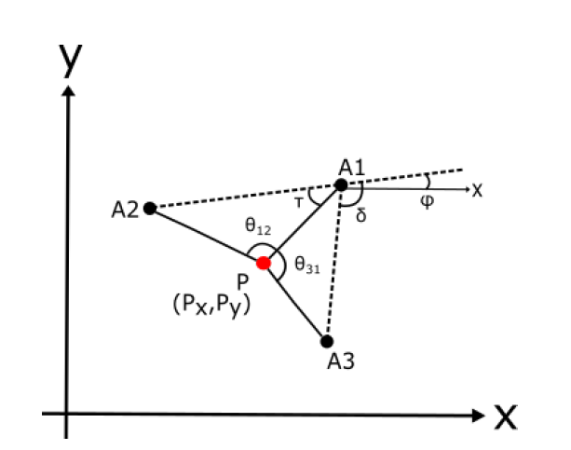
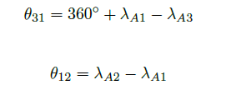

Geometric Triangulation:The algorithm is based on that the location of the anchor points are known and the fixed angles between them can be determined
Cartesian coordinates are defined as (A1;x;A1;y;A2;x;A2;y;A3;x;A3;y) for anchor-points 1-3 respectively. The angles between the anchor points and the objects are defined as (A1; A2; A3) respectively.
The angles θ31 and θ12 is directly connected to the angles between the anchor-points and the object. These are computed as follows:

Slide 14
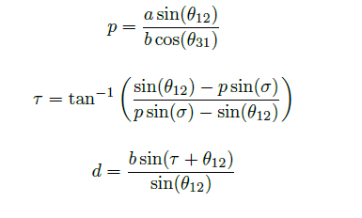
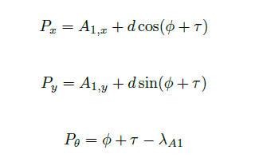
Let a and b are the euclidean distances from anchor-point 2 to 1 and 3 to 1 respectively. Then (τ) is derived as shown.
From these two equations the euclidean distance from the object to A1 can be computed and defined as d.
With the definitions and derivations the position and orientation of the object can be found and derived where Px and Py denote the coordinates and the orientation of the object is labeled as Pθ.
This method can compute the position and orientation reliably when the object is within the triangle formed by the three anchor-points. When the object is on or outside of this triangle, the method can still give good results but do not work consistently

